Slide 1
Face mask detection by using AlexNet Deep CNN
MACHINE LEARNING[A]
Group information
Name | ID
Khan, Md. Iftekhar Ahmed | 19-41201-2
Mir, Md Ishmam | 19-39925-1
Shium, Sheikh Mahmudul Hasan | 19-40764-2
Sumit kanti Sarker | 19-41764-3

Slide 2
Introduction
Face detection is the process of identifying faces in a given input image or video and indicating it by drawing a bounding box around the face. In this paper we introduce a deep learning computer vision model to recognize if a person visible through the camera is wearing a mask or not. The deep learning algorithm administered in our work is a transfer learning based Convolutional Neural Network (CNN).
AlexNet CNN is used for face mask detection.
The datasets are took from Kaggle and preprocessed the data of with mask and without mask.

Slide 3
Dataset
All the images with the face mask (~6K) are scrapped from google search and all the images without the face mask are preprocessed from the CelebFace dataset created by Jessica Li (https://www.kaggle.com/jessicali9530). Thank you so much Jessica for providing a wonderful dataset to the community.

Slide 4
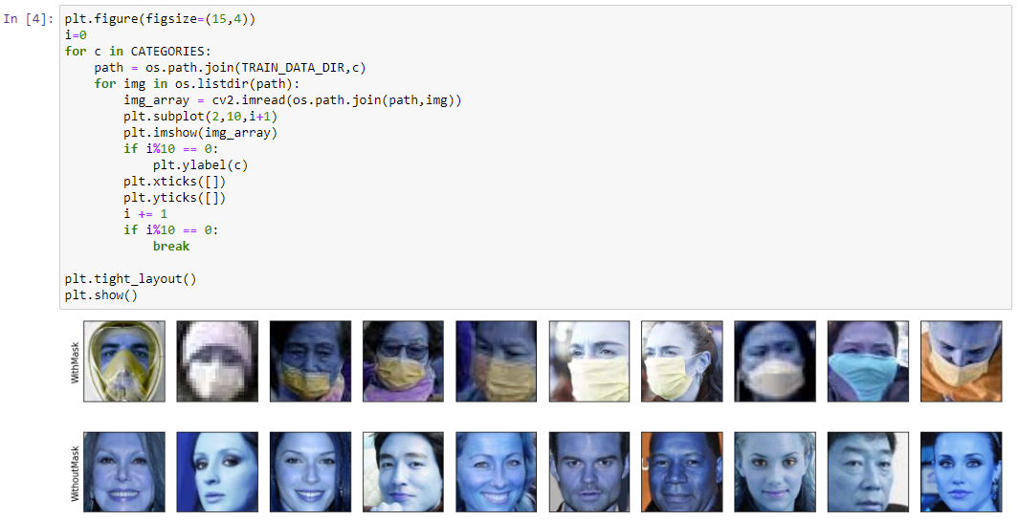

Slide 5
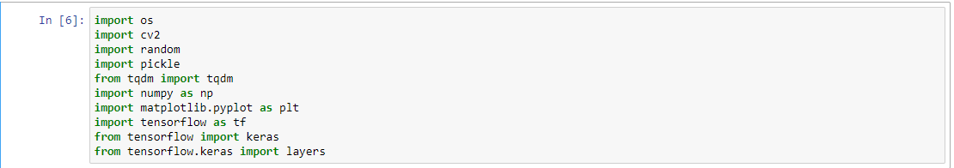
Preprocessing
First import all necessary modules, and settings

Slide 6
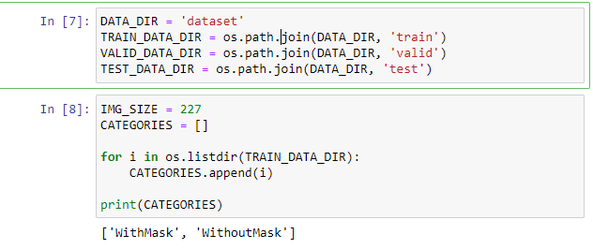
Preprocessing
Load ‘dataset’ file and split the dataset into 3 directories (train, valid, test)
The image size is set 227 and there are 2 class/labels in train data directory (‘WithMask’ and ‘WithoutMask’)

Slide 7
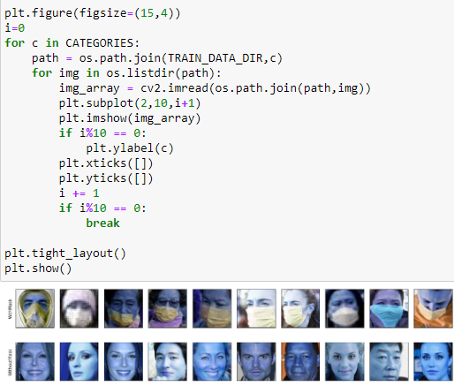
Preprocessing
Showing some sample of training data

Slide 8
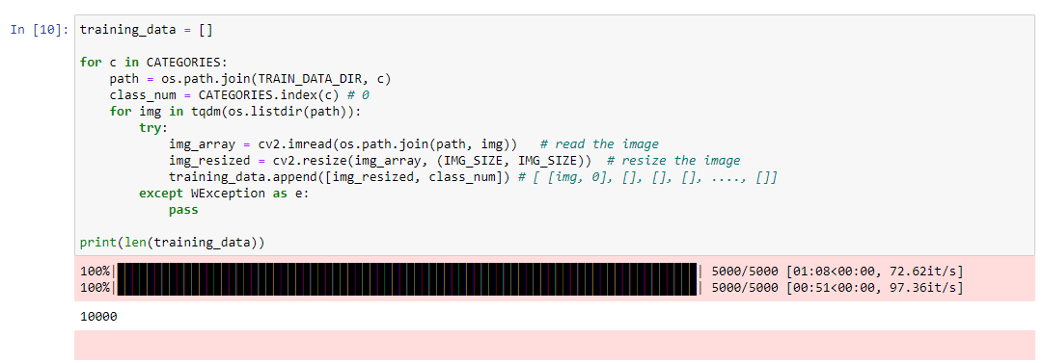
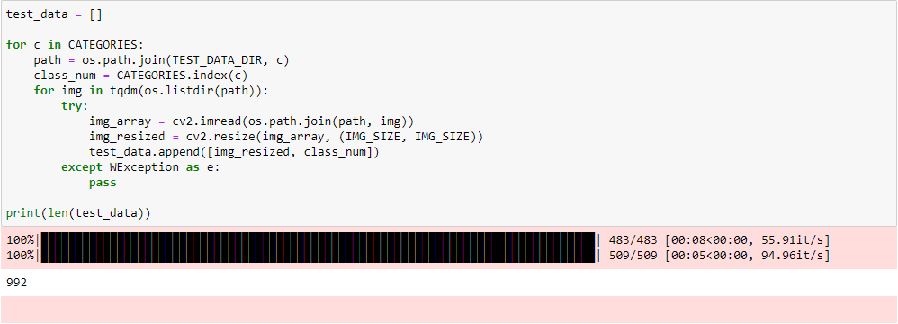

Preprocessing
Resizing training dataset, valid dataset, and test dataset

Slide 9
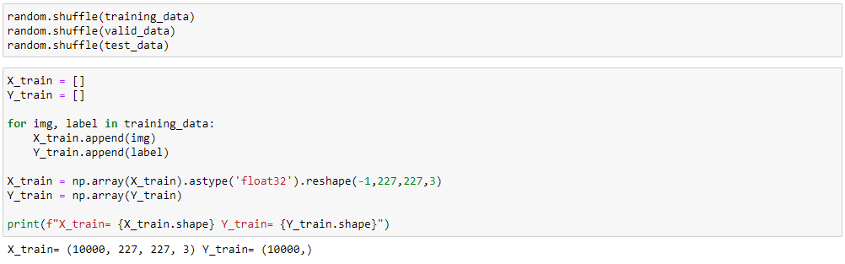
Preprocessing
Randomly shuffling all datasets to reduce possible bias. Putting images in X_train and labels in Y_train

Slide 10
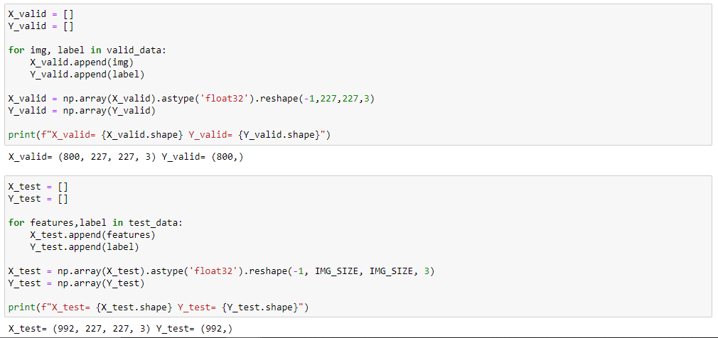
Preprocessing
Similarly putting images in X_Valid, X_Test and labels in Y_Valid, Y_Test

Slide 11
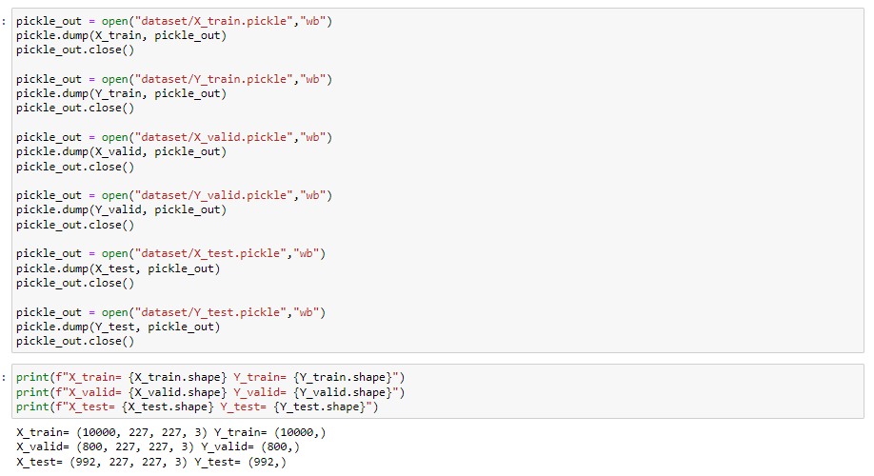
Preprocessing
Using pickle to serialize the

Slide 12
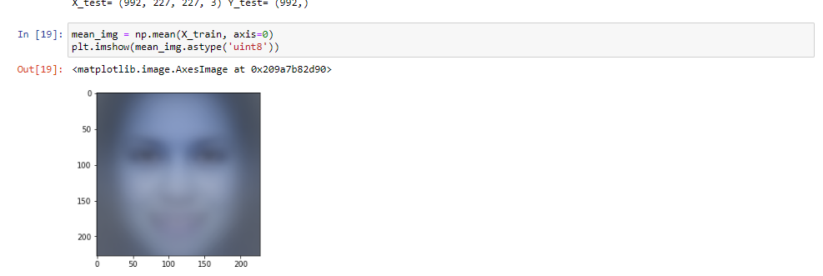
Preprocessing
Taking mean of all photos

Slide 13
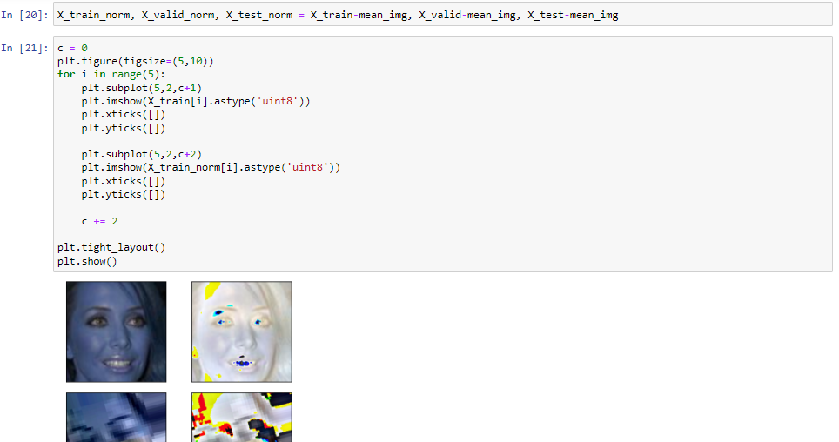
Preprocessing
Doing normalization and subtracting normalized result from the mean result

Slide 14
Architecture of Alex Net Model
The Alex Net has eight layers with learnable parameters. The model consists of five layers
with a combination of max pooling followed by
3 fully connected layers and they use Relu
activation in each of these layers except the
output layer.

Slide 15
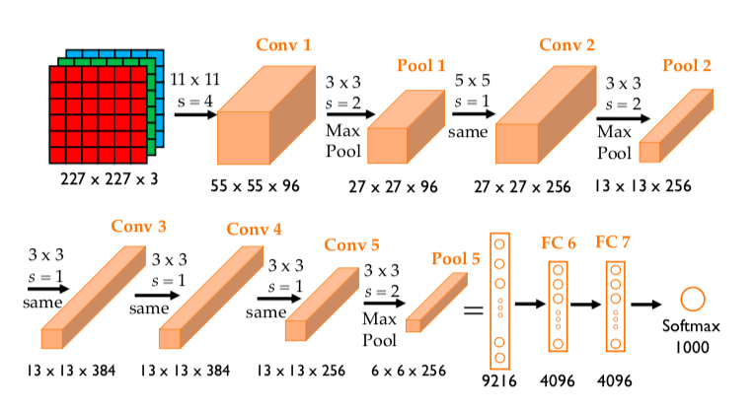
Diagram of Alex Net Model

Slide 16
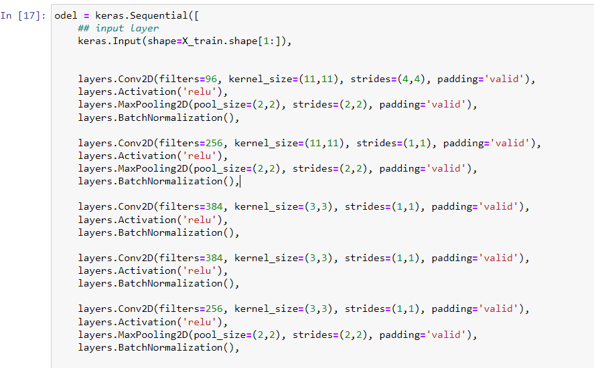
Appling Alex Net Model IN Project

Slide 17
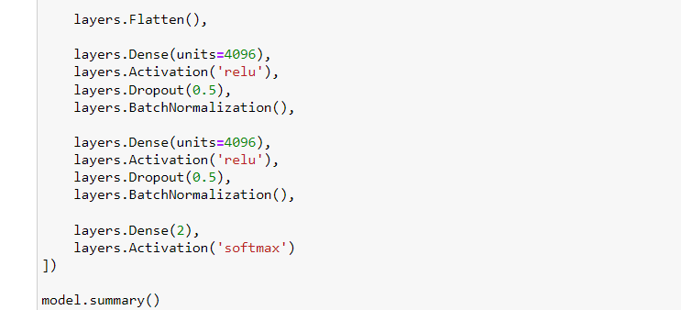
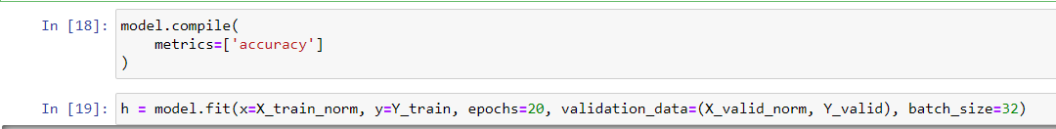
Implementing Alex Net Model On Project

Slide 18
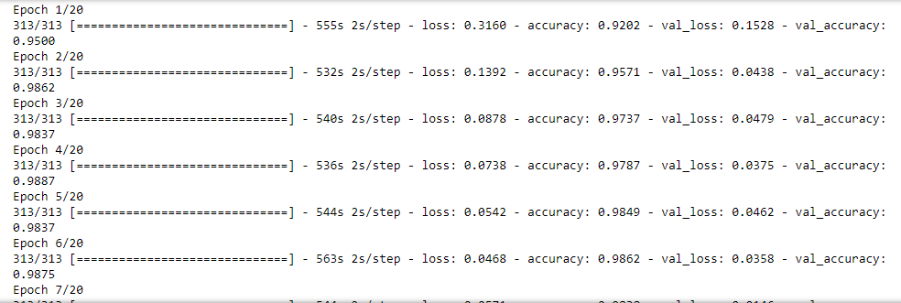
Result
Epoch details

Slide 19
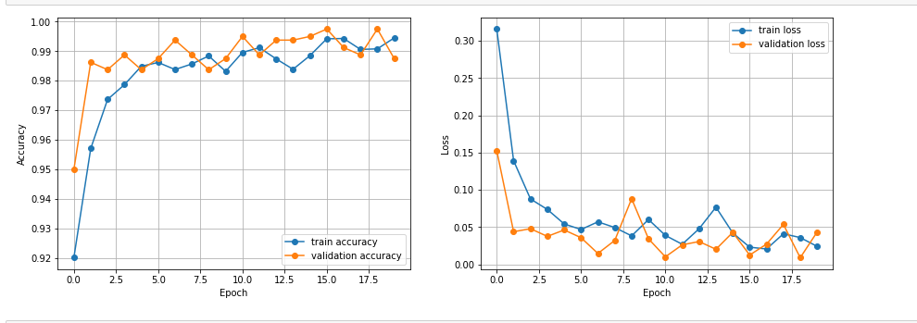
Result
Accuracy and loss of 20 epochs

Slide 20
References
Krizhevsky, Alex, Ilya Sutskever, and Geoffrey E. Hinton. "Imagenet classification with deep convolutional neural networks." Advances in neural information processing systems 25 (2012).
Kawulok, Michal, Emre Celebi, and Bogdan Smolka, eds. Advances in face detection and facial image analysis. Springer, 2016.

Slide 21
The End

